Slide 1
Build Your Agent Using Microsoft Copilot Studio
Hands-on workshop

Slide 2
Agenda
Introduction to Microsoft Copilot Studio
Lab 01: Create your first agent in Microsoft Copilot Studio
Lab 02: Authoring 101
Lab 03: Knowledge sources, AI knowledge, and custom instructions
Lab 04: Build and Invoke Power Automate cloud flows
Lab 05: Invoke AI Builder prompts
Lab 06: Make HTTP requests to connect to an API
Lab 07: Use generative AI orchestration to interact with your connectors
Lab 08: Using topic inputs
Lab 09: Advanced generative orchestration
Q&A

Slide 3
Introduction to Copilot Studio

Slide 4
Brand guidance

Slide 5
Brand Guidance
Microsoft 365 Copilot is the UI for AI – your personal, intelligent assistant for work, grounded in your data and integrated into your Microsoft apps.
Microsoft Copilot Studio is our low code tool for creating agents and extending M365 Copilot.
Agents use AI to automate and execute business processes, working alongside or on behalf of a person, team, or organization. Agents range from simple, prompt-and-response agents to more advanced, fully autonomous agents.
Notes:
The second part of the agent lifecycle is enhancing with advanced capabilities.
With Copilot Studio, you can:
Customize your agent with pro developer tools - Integrate with Azure AI Studio, Azure Cognitive Services, Bot Framework and a variety of other Microsoft conversational services.
Analyze your agent’s performance - Access built-in conversational analytics that automatically track critical KPIs.
Continuously improve the conversation - AI-driven features will help you to fine-tune your agent over time by providing suggestions on how to optimize your conversations.

Slide 6

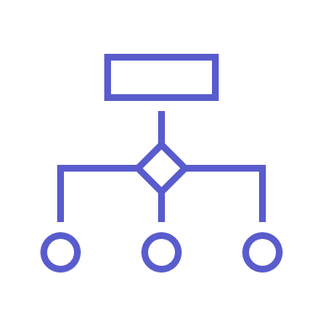

Spectrum of agents
Simple
Advanced
Retrieval
Retrieve information from grounding data, reason, summarize, and answer user questions
Task
Take actions when asked, automate workflows, and replace repetitive tasks for users
Autonomous
Operate independently, dynamically plan, orchestrate other agents, learn and escalate
Generally available
Generally available
Preview
Agents vary in levels of complexity and capabilities depending on your need
Notes:
Agents exist on a spectrum. Different organizations are at different stages of their AI transformation. Some are advanced and building the next generation of agents with autonomous capabilities. Others are still building out their AI agents to focus on retrieval and task experiences bringing their knowledge and automations into their agent experiences.
These descriptions are not official technical names for your agents. They are used to describe the capabilities that your agent may possess. All agents have the same set of components; however it is down to the makers use case and complexity that dictates where it sits across this continuum.
We recognize that agents has been an industry term used over the years. In 2024, it is mostly associated with the right side of autonomy. We believe everything is an agent and that they live on a spectrum of capability.
Retrieval: Designed with specific instructions on how to behave, their personality, and their overall objectives. They follow predefined rules and guidelines set by the creators.
Task: connected to specific workflows or processes. They operate based on knowledge, skills, and rules based automation. Their primary purpose is to automate repetitive tasks.
Autonomous: Operate independently, dynamically planning and learning from the processes. They adapt to changing conditions and make decisions without constant human intervention.

Slide 7
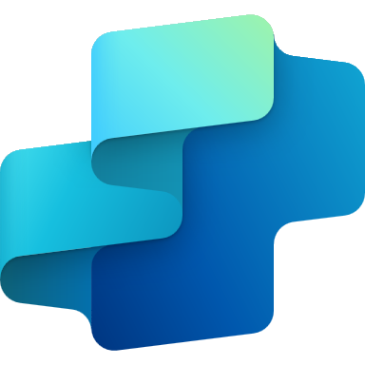

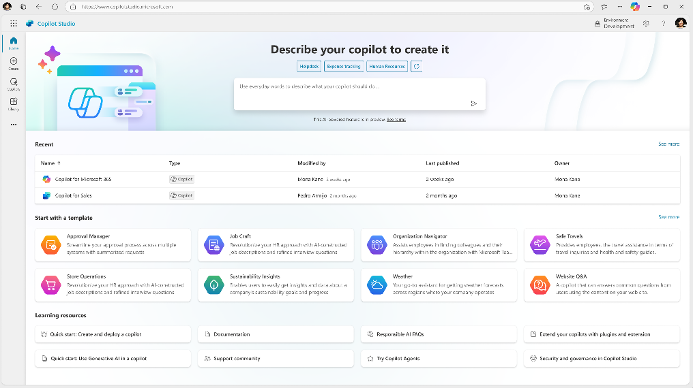
Announcement slide (dark) with color rotation
Microsoft Copilot Studio
Your agent, your way
Copilot Studio is an end-to-end conversational AI product for
building your own agent or extending Microsoft Copilot with generative AI, large language models and your data.
Notes:
Dewain

Slide 8



Different building journeys for different needs
Copilot Studio
Included in Copilot for M365
Standalone
Azure AI Studio
Customize Microsoft Copilot
Build your own custom copilots
Connect with your data sources outside of Copilots reach
Build customer or internal facing copilots with your data and workflows, on channels that work for you
Call your redesigned business processes and workflows
Rules-based dialog management and conversational orchestration with a prebuilt LLM
Configure LLMs with prompt engineering
Configure Copilot responses to specific questions
Managed SaaS, no infrastructure, built in security and governance
Manage own infrastructure, custom dev and security
Building Copilot Extensions
Build Conversational Orchestration
Build Models
Extend Copilot Studio with Azure AI Studio

Slide 9
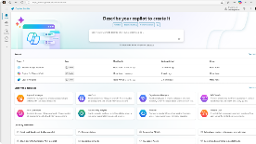
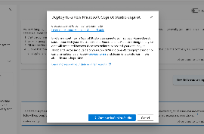
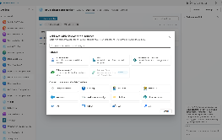
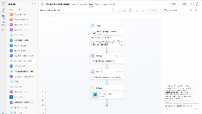
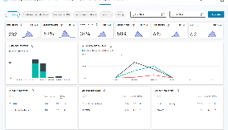
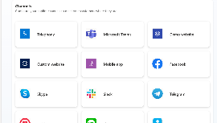
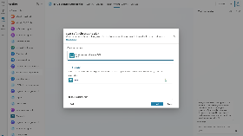
Copilot studio
Create, manage, publish and extend agents Live in minutes - all from one tool and E2E SaaS service
Chat over knowledge with Gen AI Get enterprise specific answers over your files, websites, internal shares, Dataverse, third party systems and more
Integrate with AI Services Integrate with Azure AI Studio, Azure Cog Services, Bot Framework and various other Microsoft conversational services
Build & Publish
Create specific topics Supplement generative responses with specific, curated topics where you want tight control. Build them easily with the powerful graphical studio
Monitor and Improve with rich out-of-the-box insights and analytics
Copilot Studio
Build actions & Plugins Create actions, plugins, use 1000s of pre-built connectors or Power Automate to call your backends and APIs
Publish to multiple channels, and go live instantly on the SaaS service or choose to extend Copilot for Microsoft 365 with your custom capabilities
Analyze & Improve
Notes:
Marius

Slide 10
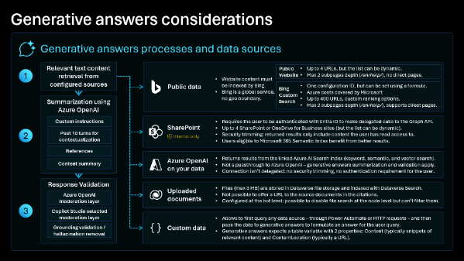
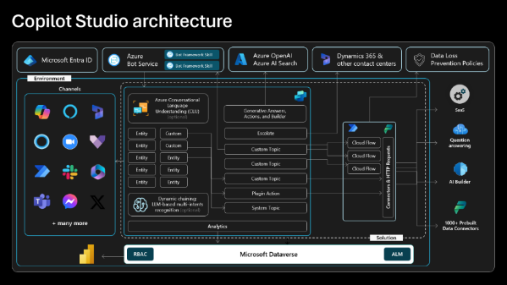

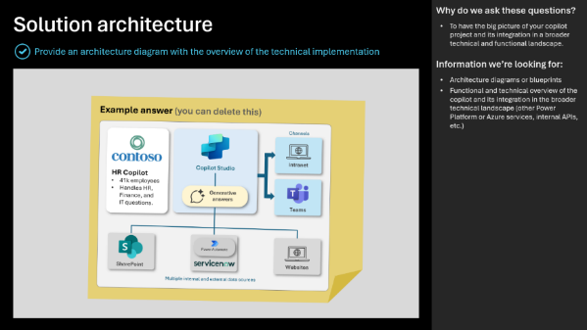
Copilot Studio Implementation Guide
The Copilot Studio implementation guide provides a framework to do a 360-degree review of a agent or bot project.
Through probing questions, it highlights potential risks and gaps, aims at aligning the project with the product roadmap, and shares guidance, best practices and reference architecture examples.
aka.ms/CopilotStudioImplementationGuide

Slide 11
Get Started

Slide 12
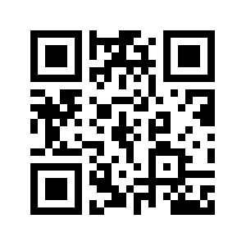
Go to aka.ms/CopilotStudioWorkshop
THEN:
Download and unzip the lab files locally.
Using the provided credentials, log in aka.ms/CopilotStudioStart
SCAN ME

Slide 13
Important lab instructions
Follow the labs most lab content is dependent on previous labs.
If you want to deviate from the labs and test your own scenarios, this is fine, but please do complete the labs first, and create your own separate custom agent for your own scenarios and exploration after you’ve completed the labs.
Using a Mac? Use Chrome or Edge as there is known issue being fixed.
Trouble copy-pasting the content from PDFs? Use Word versions.

Slide 14
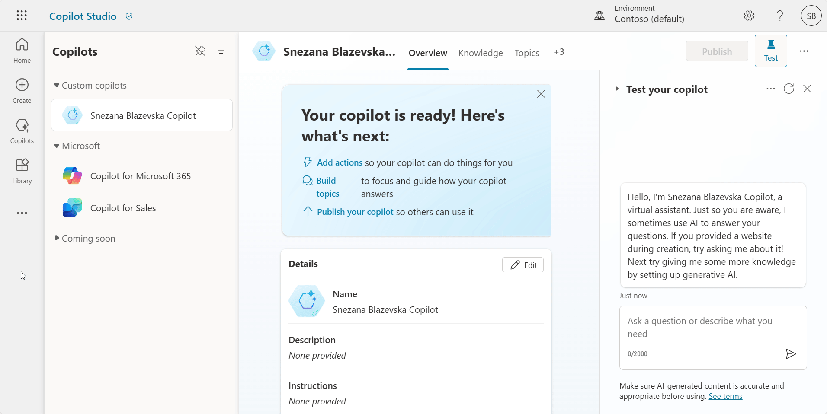
Productivity tip #1: Unpin the Copilots pane

Slide 15
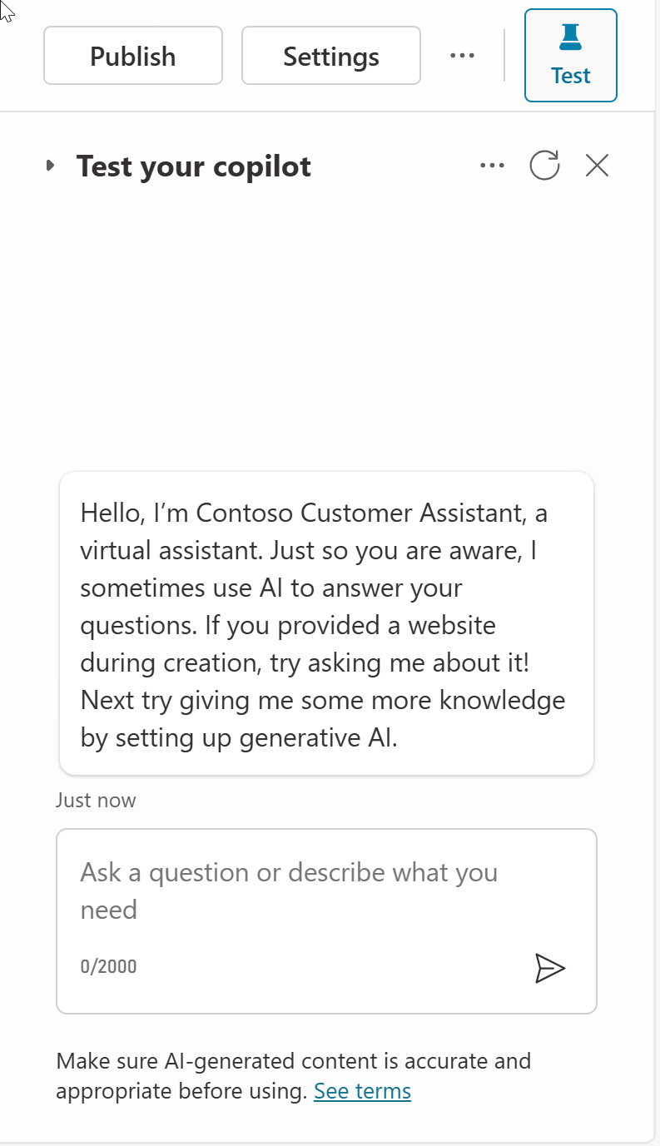
Productivity tip #2: Refresh the conversation between tests

Slide 16
Lab 01: Create your first agent in Microsoft Copilot Studio

Slide 17
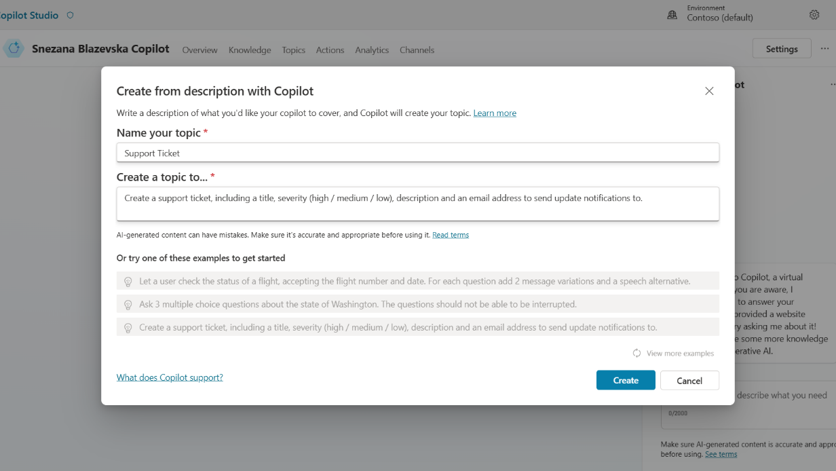
Copilot for Copilot Studio
AI assistance in building topics, designing and modifying the agent all through natural language
Assisted authoring for:
Topic creation
Topic iteration
Response generation
Adaptive Card generation
Topic improvement suggestions
Suggested trigger phrases, topic names, topic descriptions
Transcript generation
Copilot creation
Topic suggestions
Azure bots take months to author
Copilots took days to author
Prompt-authored copilots will take hours or even minutes to author.

Slide 18
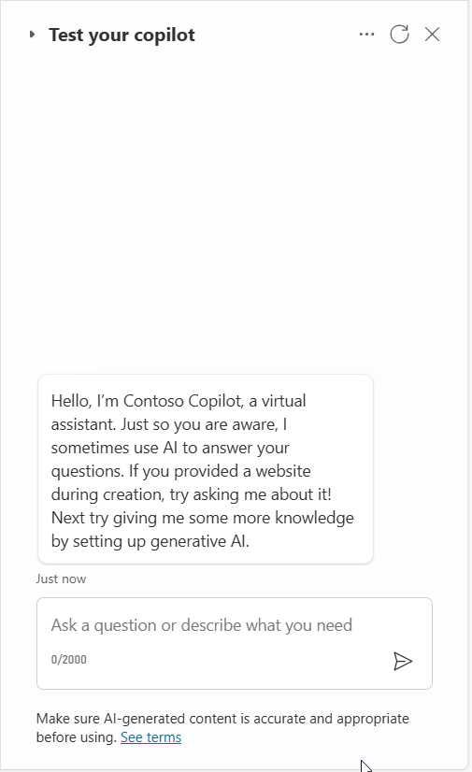
Demo Lab 1

Slide 19
Lab time!
Lab 01 [40] minutes

Slide 20
Lab 02: Authoring 101

Slide 21
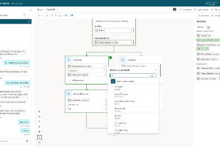
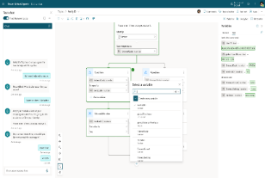
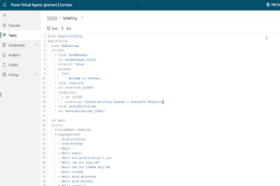
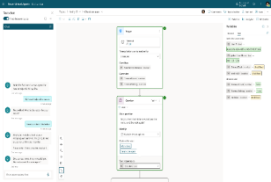
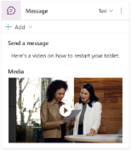

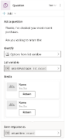




Copilot Studio authoring canvas
Rich Responses
Power Fx-based variables system
Code side-by-side
Event-driven & contextual triggering
Productivity
New features including:
Power Fx integrated formula editor for variable management
List / Record type support
Condition nodes with Power Fx formula support
Iterate over a List with new Loop nodes (coming soon)
Move between a visual editor and code
Share and re-use topic logic between developers and bots
Trigger an event that can interrupt Dialogs if it detects a certain value has been received
Add more nuanced responses to a message when the bot runs into an issue.
Bots can stay within context when a user asks for additional help or more details
Cut, Copy, Paste
Multi-node selection
Enhanced topic navigation
Adaptive Cards
Images
Videos
Quick Replies

Slide 22
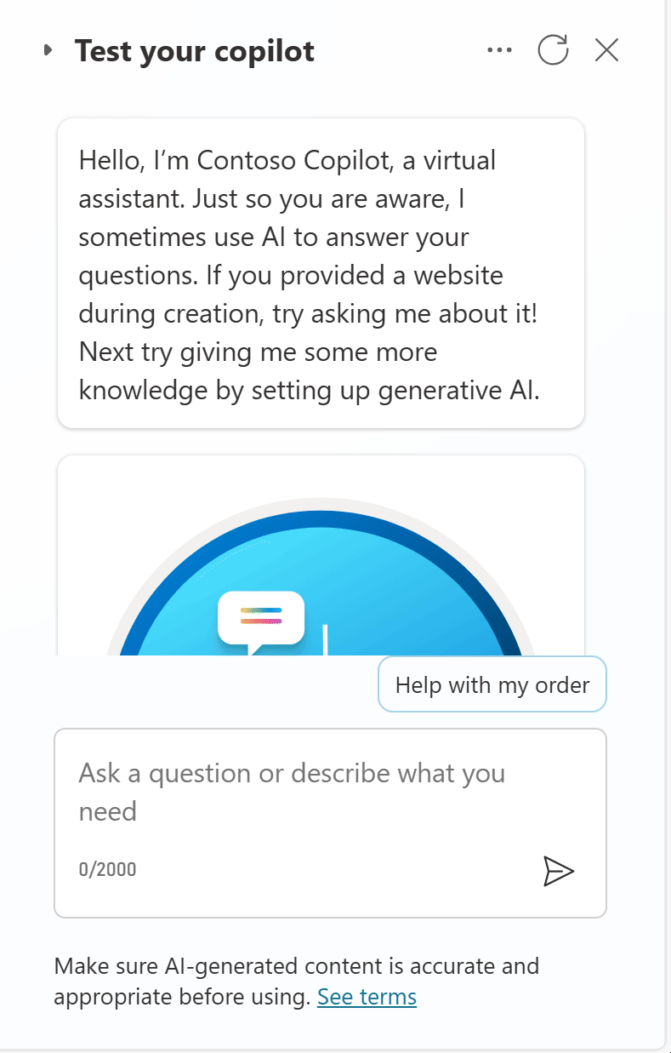
Demo Lab 2

Slide 23
Lab time!
Lab 02 [60] minutes

Slide 24







Disambiguation with topic design
Natural Language Understanding Trigger phrases | “Trigger Phrases” Topics Triggered from trigger phrases or redirects | Reusable, Bite-Size, Topics Explicitly called by topics
Topic: Card
Topic: Debit Card
Issue with my card
Block card
I need to block my credit card
Need help blocking debit card
Unblock card
Need to unblock credit card
How to unblock my debit card
Question: Debit/Credit
…
Question: Block/Unblock
Condition
Topic: Credit Card
Debit
Credit
…
End of Conversation
Topic: End of Conversation
Topic: Location
…
Find my nearest bank
Check branch location
Find a bank
Find me your nearest location
Banks near me
Question: Location
Location
Topic: Location Check
Message
…
End of Conversation

Slide 25



Natural language understanding
Standard NLU model
Custom Azure CLU model
Generative orchestration
Default, out-of-the-box, model that comes pre-trained, with many predefined entity types.
Configuration is done by adding trigger phrases and custom entities (either closed lists with values and synonyms, or regular expressions).
Supports additional languages, with native models.
Allows to further customize the intent triggering model for better intent recognition or to address specific industry requirements.
Allows for complex entity extraction (e.g., of the same type).
Entity extraction can also leverage Copilot Studio standard NLU.
Uses a GPT large language model.
Can handle multiple intents and chain topics and/or plugins.
Automatically generate questions for missing inputs and answers complex entities and questions from the conversation context.
Configuration is done by simply describing topics, plugin actions, and inputs/outputs.
Single intent recognition per query.
Cannot be extended.
Slot-filling multiple entities of the same type in the same query requires disambiguation for each (e.g., from and to cities)
Single intent recognition per query.
Configuration is done in Azure and involves additional costs.
Has its own service limits that need to be evaluated.
Azure CLU intents and Copilot Studio topics must be carefully kept in sync.
As it’s a generative AI feature, the licensing burn rate of messages is higher than in regular topic triggering.
Preview capability.

Slide 26
Handling unrecognized intents
Answering for unplanned user queries
1
3
The fallback topic gets triggered when Copilot Studio doesn't understand a user utterance and doesn’t have sufficient confidence to trigger any of the existing topics.
If knowledge sources are enabled on the agent, the conversational boosting topic also triggers on the unknown intent event and triggers before the Fallback one.
2
4
There are many ways to handle unrecognized intents: using the AI’s own general knowledge, or knowledge sources to ground the answer in your own data sources and/or using the Fallback topic to integrate with any other systems. For example, question answering in Azure AI for Language allows you to offload large volumes of question-and-answer pairs. It also has a chitchat model to handle random questions to the agent.
While it’s important to leverage the Conversational Boosting and Fallback capabilities, it’s also important to make sure that the core scenarios and topics of your copilots are property handled through custom topics and their outcomes defined (resolved, etc.).

Slide 27
Lab 03: Knowledge sources, AI knowledge, and custom instructions

Slide 28
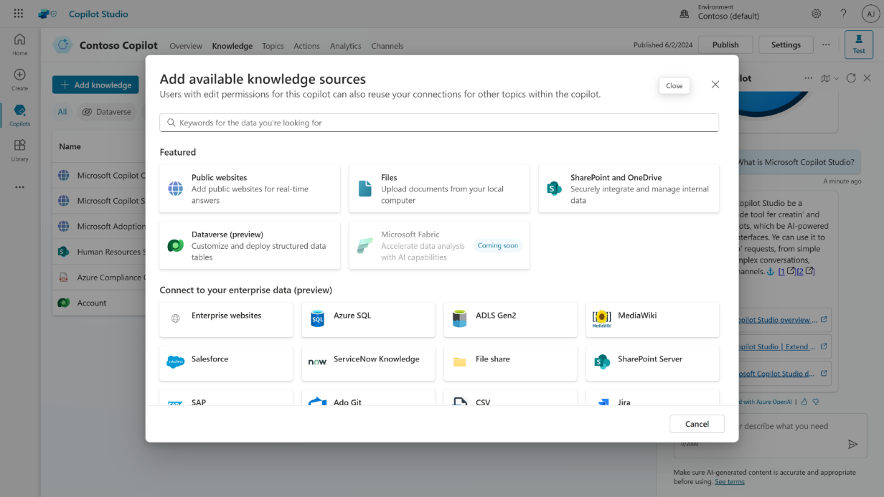
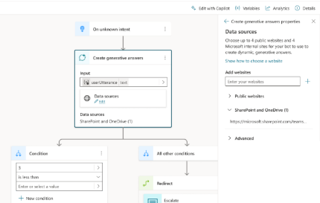
Knowledge sources
Enable multi-turn chat over your own internal and external knowledge sources and sites with generative answers
Copilots can answer thousands of questions out of the box in seconds
You can even pull data from an API or other backend system and enable generative chat over it

Slide 29












Knowledge sources & Generative AI
Public data
Public Website
Max 2 subpages depth (/en/help/), no direct pages.
Websites must be indexed by Bing.
Bing being a global service, no regional boundary is possible.
One configuration ID, but it can be set using a formula.
Azure costs covered by Microsoft
Up to 400 URLs, custom ranking options.
Max 2 subpages depth (/en/help/), supports direct pages.
Bing Custom Search
1
Query rewriting
Optimizing the user question for search
SharePoint
Requires the user to be authenticated with Entra ID to make delegated calls to the Graph API.
Matching files (max 3 MB) are retrieved to get detailed snippets to summarize.
Security trimming: returned results only include content the user has read access to.
Users eligible to Microsoft 365 Semantic Index benefit from better results.
Last 10 turns are leveraged for contextualization
Internal only
2
Content retrieval
Azure OpenAI on your data preview
Returns results from the linked Azure AI Search index (keyword, semantic, and vector search).
Not a passthrough to Azure OpenAI – generative answers summarization and validation apply.
Connection isn’t delegated: no security trimming, no authentication requirement for the user.
Can index content from public URLs/web addresses (useful if regional boundary is required).
Querying each source
Top 3 results per source
Files
3
Summarization
Files (max 512 MB) are stored in Dataverse file storage and indexed with Dataverse Search.
Not possible to offer a URL to the source documents in the citations.
Documents are uploaded at the agent level. Gen Answers node will search across all uploaded documents or none, when disabled at a node level.
Answer summarization from retrieved content
Citation generation
Requires a step to query the data source – using cloud flows, connectors, or HTTP requests.
Results are passed as inputs to the generative answers to summarize an answer for the query.
Input data needs to be in table format, with 3 properties: Content (typically snippets of relevant content) , ContentLocation (optional, typically a URL) and Title (optional).
Custom data
Answer personalization with custom instructions
Validation at each step
Dataverse preview
Moderation of harmful, malicious, uncompliant, or copyrighted answers
Dataverse tables (max 15).
Natural language queries are transformed in analytical queries (e.g., SQL) over structured data
Grounding validation and hallucination removal
Connect to additional enterprise knowledge sources that are indexed in Microsoft Graph.
Salesforce, ServiceNow, Confluence, Azure DevOps Wiki, etc.
Graph Connectors preview

Slide 30










Generative AI security and compliance considerations
The large language models (LLM) Copilot Studio depends upon are the foundation models trained by OpenAI.
Generative answers uses GPT-3.5 Turbo for summarization, but will soon be updated to GPT-4o as of Sep 2024.
Models are hosted on internal Azure OpenAI services, honoring the Microsoft Services Trust boundary.
Models are accessed and used following Microsoft Responsible AI principles and policies.
Custom instructions can be added to generative answers to influence format and filters.
Data storage and processing for Copilot Studio generative AI capabilities may result in data movement across regional boundaries. When local data storage and processing aren’t available in the region, environment settings are available to disable features requiring Azure OpenAI or Bing Search, preventing data movement.
Copilot Studio does not collect, nor provide any customer data, for use in the training of LLMs.
For operations purposes only, conversations are stored temporarily in a service-operated and secured store so that authorized Microsoft employees via Secure Access Workstations (SAWs) with Just-In-Time (JIT) access requests may respond to support requests. Access can be controlled through Customer Lockbox.
Generative AI capabilities log additional troubleshooting data, but only when the thumbs up or down reactions are used by the agent author in the Copilot Studio test pane.
Given the existing control layers and to avoid further logging of customer data, Azure OpenAI abuse monitoring is disabled for Copilot Studio generative AI features.

Slide 31
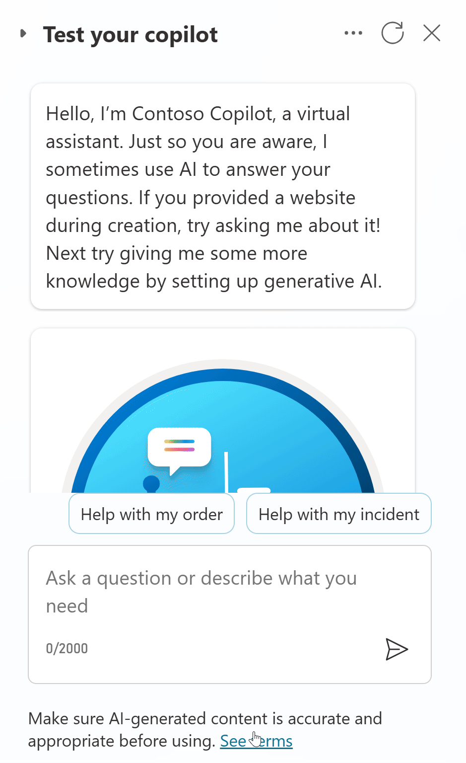
Demo Lab 3

Slide 32
Lab time!
Lab 03 [30] minutes

Slide 33
Lab 04: Build and call Power Automate cloud flows from your agent

Slide 34



Integration patterns considerations
Power Automate Cloud flows
HTTP requests
& Connectors
Bot Framework
Skills
No-code / low-code.
Clear separation of integration and conversational logic.
Can be monitored separately.
Existing cloud flows can be updated to integrate with Copilot Studio.
No-code / low-code.
Faster runtime execution.
Can be monitored as part of Copilot Studio App Insights integration.
Can leverage variables, including environment variables and secrets.
Variables, conditions, parameters, etc. can use Power Fx formulas.
Parsing and error handling support.
Synchronous execution.
Support for private endpoints.
Existing Bot Framework investments can be reused.
Invocation and execution of the cloud flow can add latency.
If scale/performance are a concern, the higher-tier “Power Automate Process” plan can be evaluated.
“Power Automate Process” required for service principal ownership.
Need to return results within 100s.
Mixing conversational logic and integration logic, but integration topics can be isolated, as they can be configured for inputs and outputs.
Need to return results within 100s.
Pro-code (e.g., C#)
Runs in the Azure AI Bot Service.
Additional costs need to be covered by an Azure subscription.
ALM differs from Power Platform.

Slide 35
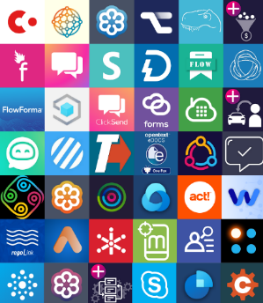


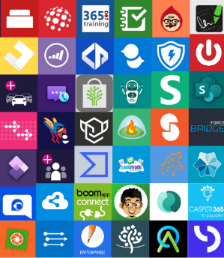



Power Platform Connectors
Multi-Channel
Power Platform, including Power Automate and Copilot Studio, offers great integration capabilities, with more 1,200 native connectors or ways to create your own custom connectors to your APIs.
For a good end-user experience, cloud flows, HTTP requests and connectors triggered from Copilot Studio must execute quickly so that the user doesn’t have to wait too long for the agent to answer.
Website
Mobile
Teams
Facebook
Power Automate
Telephony
Email
Slack
Copilot
Studio
Direct line Speech
Many more
1200+ prebuilt data connectors

Slide 36
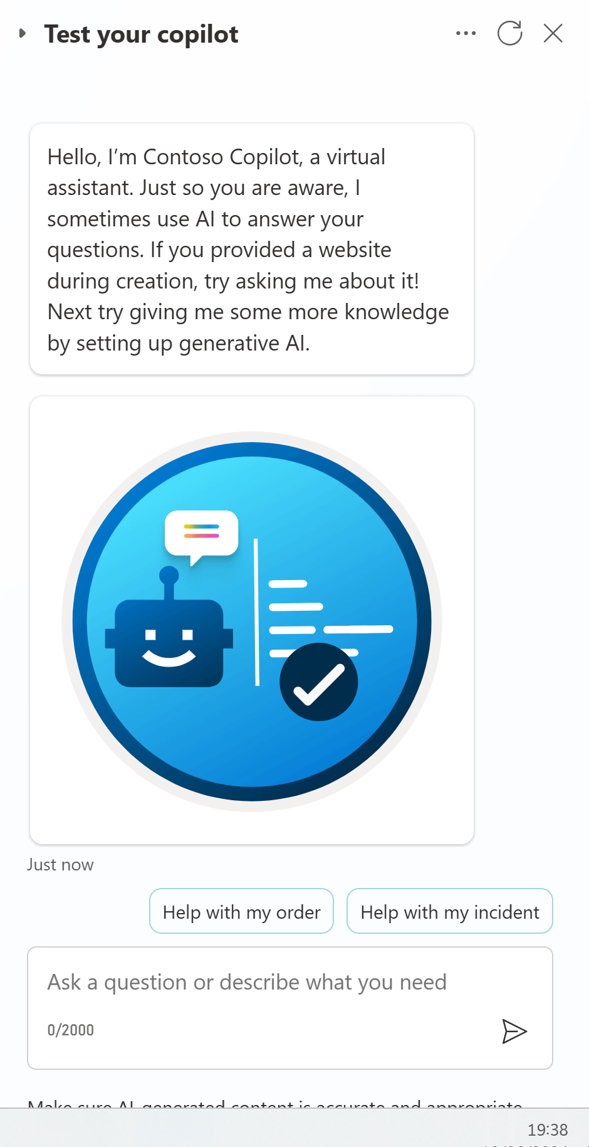
Demo Lab 4

Slide 37
Lab time!
Lab 04 [60] minutes

Slide 38
Lab 05: Invoke AI Builder prompts

Slide 39
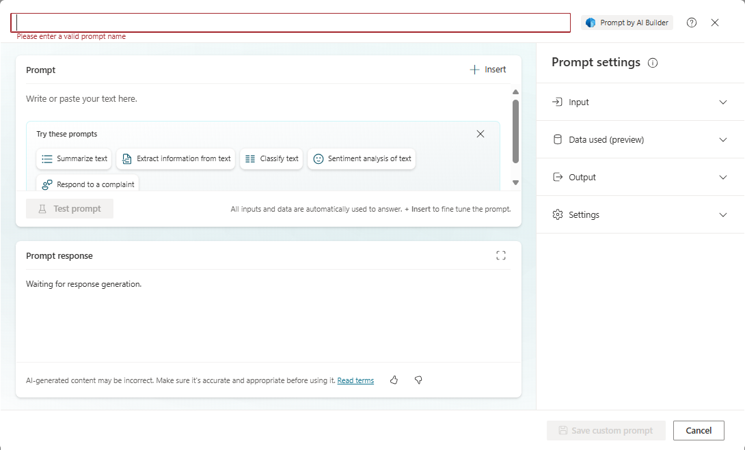
AI Prompts

Slide 40
Best practices for prompt instructions
Be specific: Custom instructions should be clear and specific, so the agent knows exactly what to do. Avoid vague or ambiguous language that could lead to confusion or incorrect responses.
Use examples: Provide examples to illustrate your instructions and help the agent understand your expectations. Examples help the agent generate accurate and relevant responses.
Keep it simple: Avoid overloading your custom instructions with too many details or complex logic. Keep your instructions simple and straightforward so the agent can process them effectively.
Give the agent a way out: Give the agent an alternative path for when it's unable to complete the assigned task. For example, when the user asks a question, you might include "respond with 'not found' if the answer isn't present." This alternative path helps the agent avoid generating false responses.
Test and refine: It's important to test your custom instructions thoroughly to ensure they're working as intended. Make adjustments as needed to improve the accuracy and effectiveness of your copilot's responses.

Slide 41
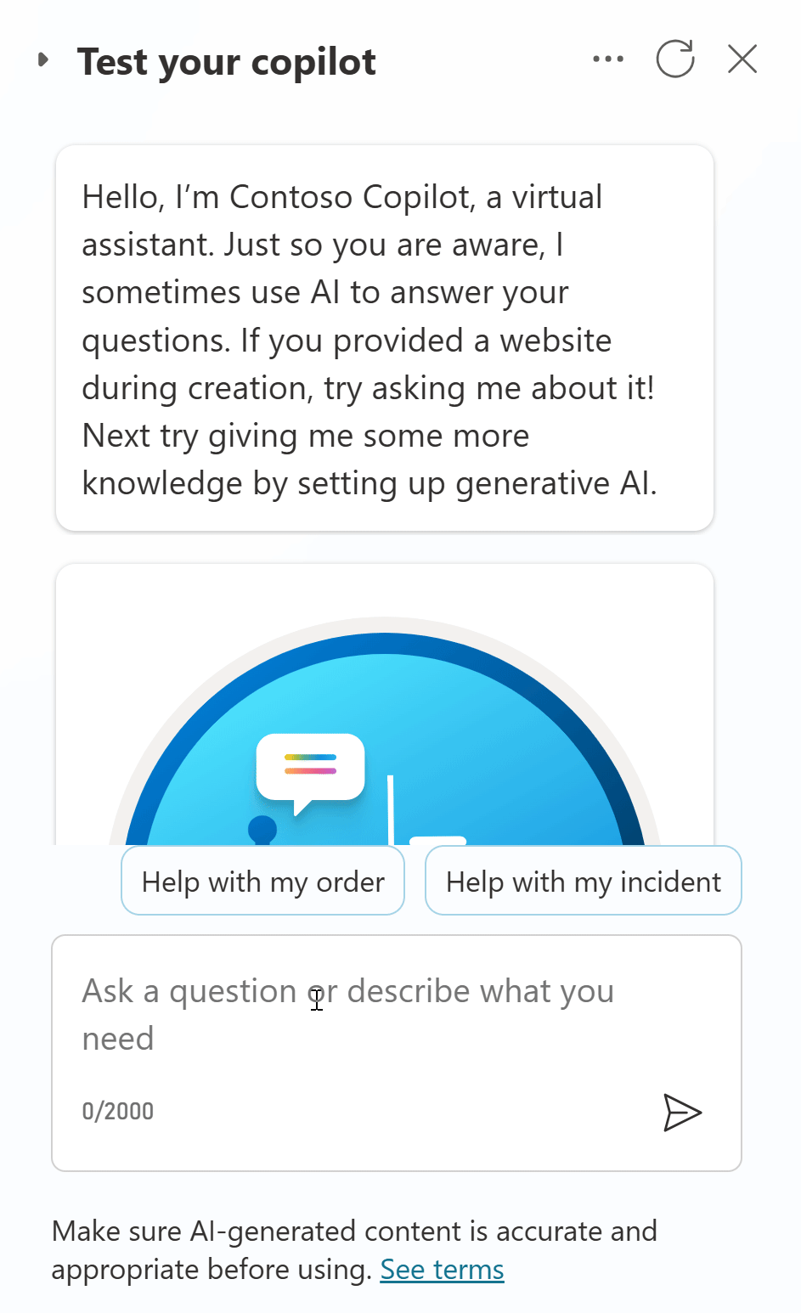
Demo Lab 5

Slide 42
Lab time!
Lab 05 [25] minutes

Slide 43
Lab 06: Make HTTP requests to connect to an API

Slide 44
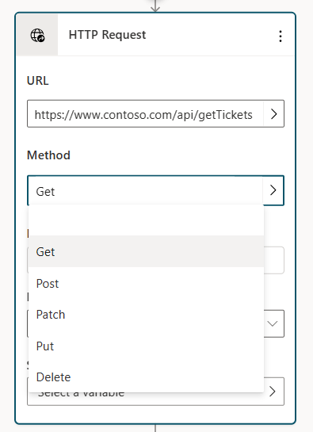
HTTP request
In Copilot Studio, you can extend an agent capabilities by calling external REST APIs using the HTTP request node.
This call can be helpful when you need to retrieve data from an external system.
You can use different methods and inject your own header and body.
The response can be parsed in JSON format following a sample schema.
The HTTP request node has multiple options for handling situations where the HTTP request might fail or return an error.

Slide 45
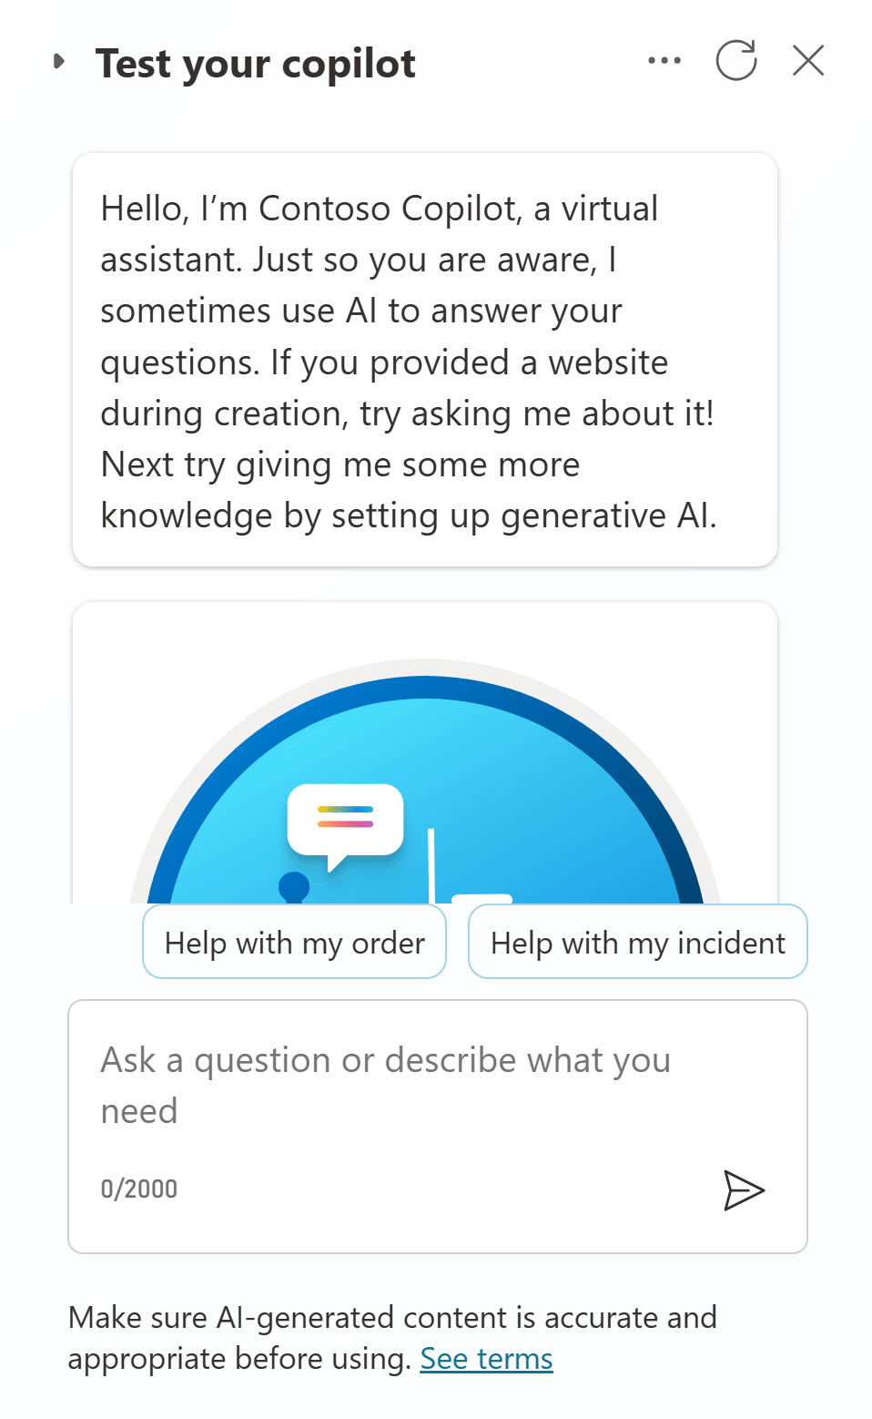
Demo Lab 6

Slide 46
Lab time!
Lab 06 [20] minutes

Slide 47
Lab 07: Use generative orchestration to interact with your connectors

Slide 48
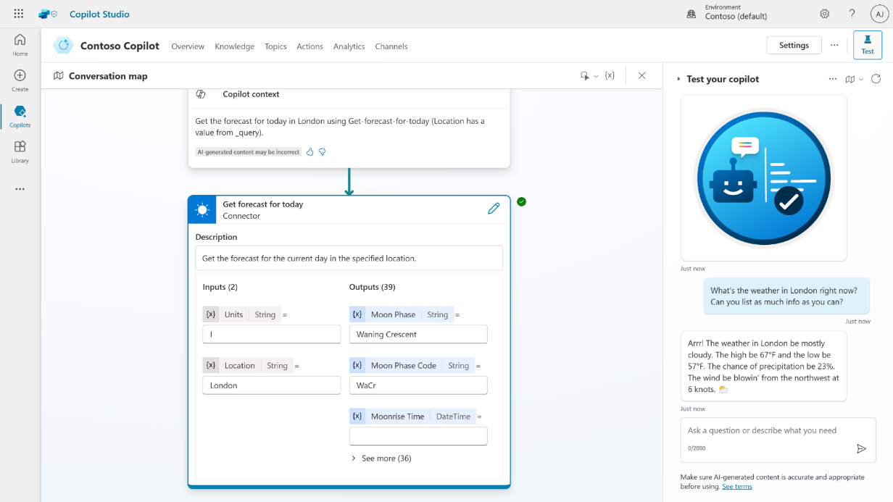
Generative orchestration
Test and trace feature to see it in action
Dynamically chains actions and topics together to produce actionable responses
Handle multi-intent queries that were not anticipated or built by the user
Automatically slot-fill further details to get the information needed for the task
Powered by the Azure OpenAI Service with LangChain concepts
Public Preview

Slide 49
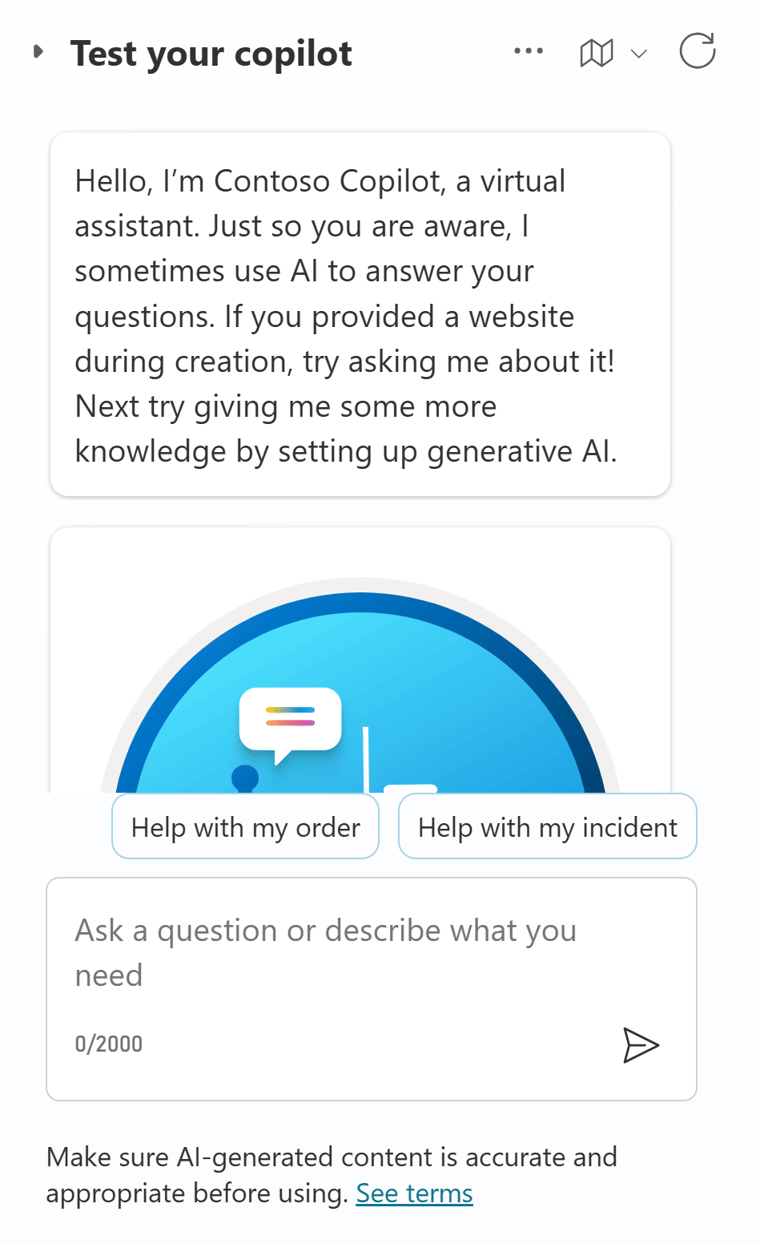
Demo Lab 7

Slide 50
Lab time!
Lab 07 [20] minutes

Slide 51
Lab 08: Using topic inputs

Slide 52
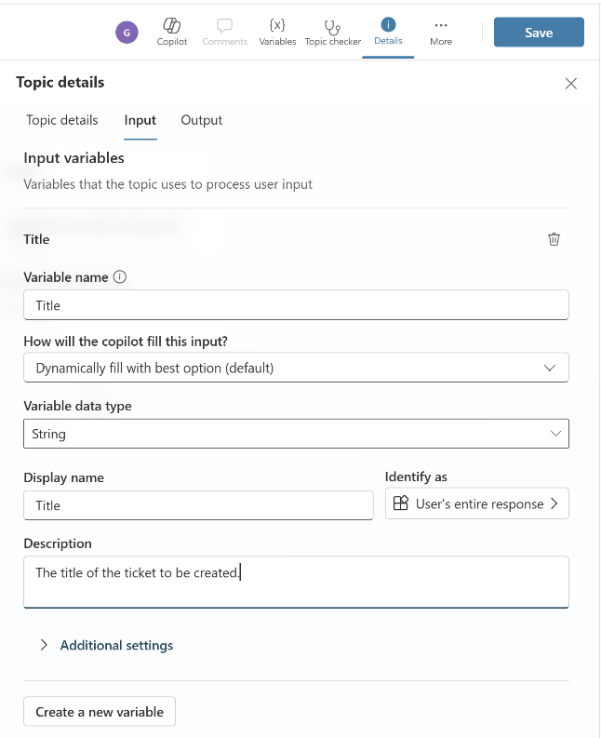
Topic inputs and outputs
Topics can have input and output parameters. When a topic redirects to another topic, you can use these parameters to pass information between topics.
If your agent uses generative AI to decide how to respond to users, it can automatically fill inputs, before running the topic, by using conversation context or generate questions to collect values from the user's response.

Slide 53
Lab time!
Lab 08 [15] minutes

Slide 54
Lab 09: Advanced generative orchestration

Slide 55
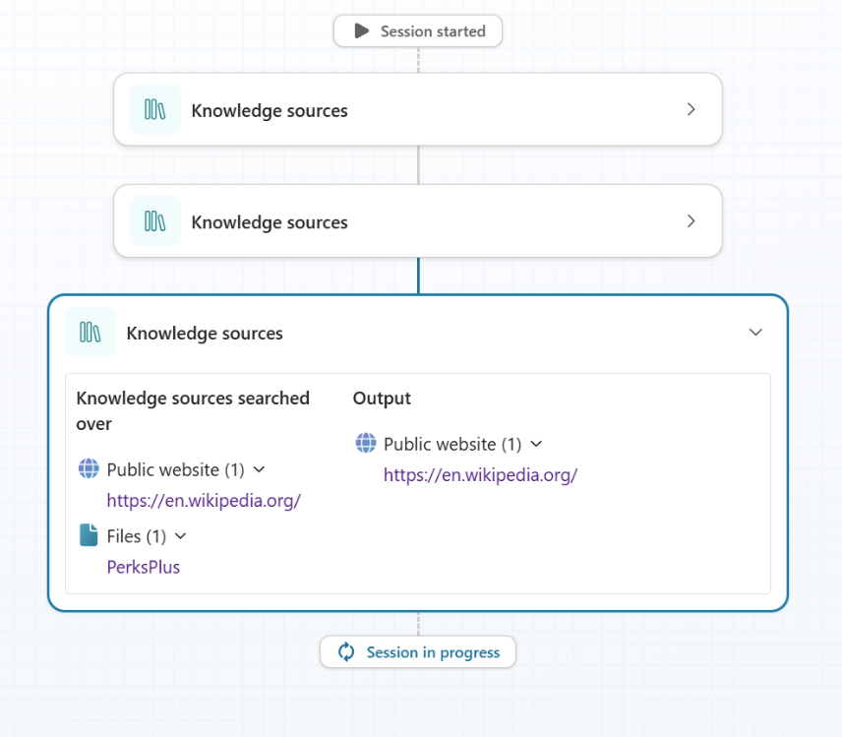
Advanced generative orchestration
In generative mode, an agent can select multiple actions or topics at once, to handle multi-intent queries. Once actions and topics are selected, the agent generates a plan that determines their execution order.
Once the plan is executed, you can manipulate the unified response using the “plan complete” trigger.

Slide 56
Lab time!
Lab 09 [25] minutes

Slide 57

Q&A
SHARE YOUR FEEDBACK!
aka.ms/PPCC2024Workshop

Slide 58
Resources

Slide 59
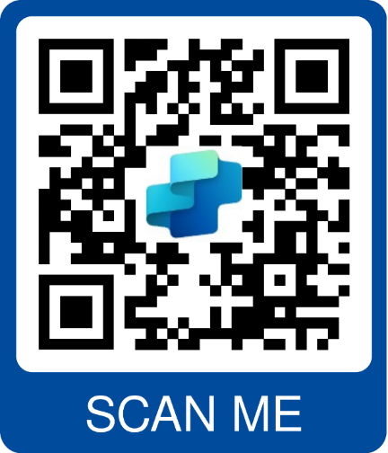
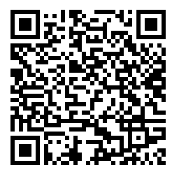

Resources
Copilot Studio trial | aka.ms/TryCopilotStudio
Copilot Studio website | aka.ms/CopilotStudio
Official Blog | aka.ms/CopilotStudioBlog
Copilot Studio Demo | aka.ms/CopilotStudioDemo
Copilot Studio Kit | aka.ms/CopilotStudioKit
Product documentation | aka.ms/CopilotStudioDocs
Product guidance | aka.ms/CopilotStudioGuidance
Implementation guide | aka.ms/CopilotStudioImplementationGuide
Community | aka.ms/CopilotStudioCommunity
Follow-up Session on 1/31

